Slide 1

Students: Quyen Hoang Carl Demolder
Mentors:
Moran Amit, PhD Prof. Tina Ng
Prof. Hari Garudadri
t o t o u c h
p r o v i d i n g
d a t a

Slide 2
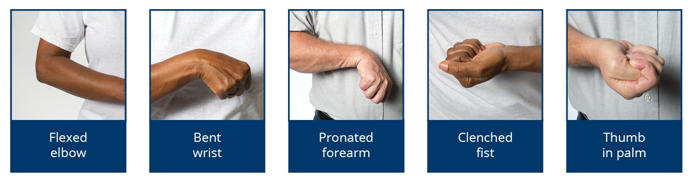
Problem: Spasticity
Cause: Upper-Motor Neuron Dysfunction
Symptoms: Muscle Stiffness, Involuntary, Rough Limb Movements, and Painful Contractures
Complications: Severe Bone/Joint Deformities & Inhibition of Protein Synthesis of Muscle Cells

Slide 3
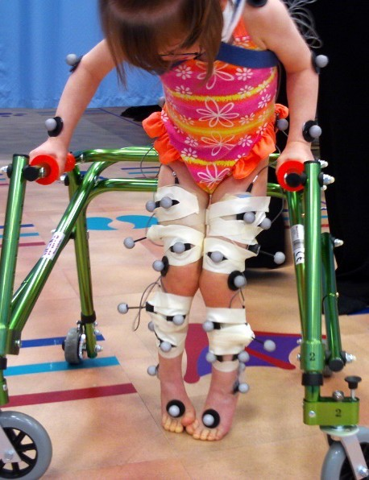
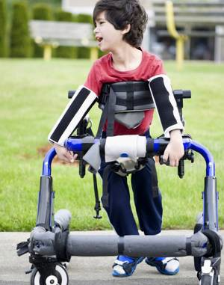
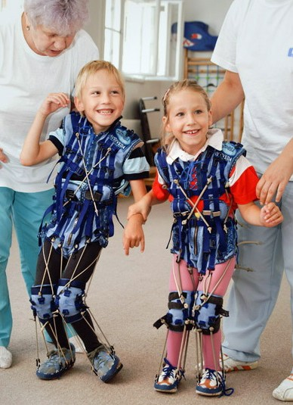
Prevalence: Spasticity
Diagnosed In:
-Multiple Sclerosis
-Stroke
-Traumatic Brain Injury
-Spinal Cord Damage
-Cerebral Palsy (0.4% Live Birth Rate)

Slide 4
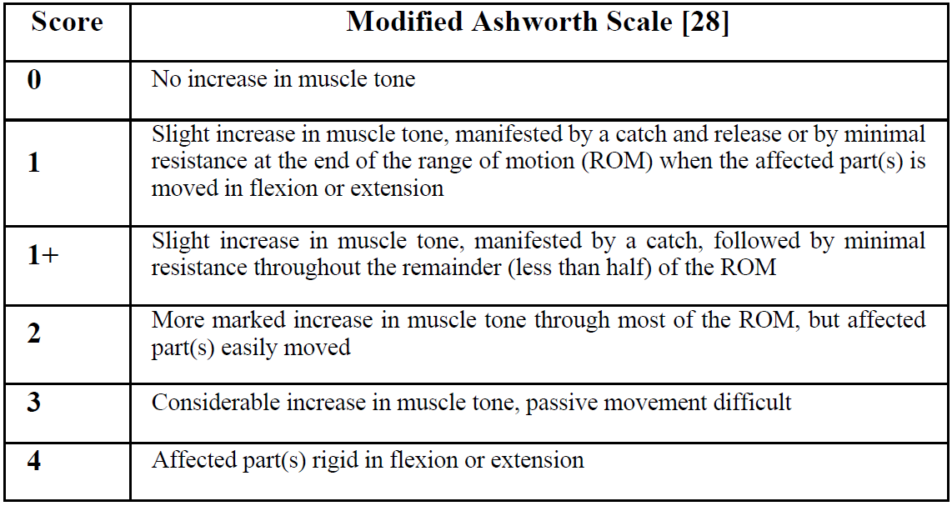
Clinical Assessment:
Qualitative Evaluation:
-Modified Ashworth Scale
-Tardieu Scale
-Tendon Reflect Scale
Subjective:
-Therapists’ Feelings and Experiences
-Lack of a Sensitivity and Consistency
-May affect Patients’ Health and Treatment

Slide 5
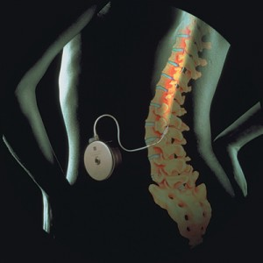
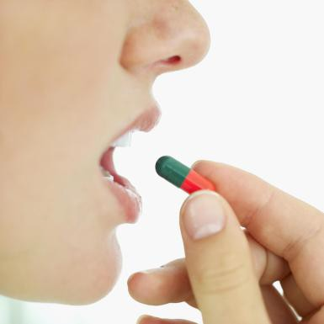
Treatment Methods:
-Spasticity = Non-Curable
-Medication to Reduce Symptoms
Intrathecal Drug Therapy
Oral Medication
Excessive Drug Doseage:
-Severe Side Effects
-Seizures, Coma, Hypothermia
-Respiratory Depression
-Loss of Consciousness
Inadequate Drug Doseage:
-Ineffective Treatment of Spasticity

Slide 6
Market/Product Need:
Spasticity Evaluation Critical:
-Selecting appropriate Treatment
-Evolution of Spasticity over Time
-Monitoring Patient’s Response to Drugs & Therapies
Quantitative Evaluation of Spasticity:
-Robust Device
-Sensitive
-Consistent
-Reliable
-Repeatable Tests

Slide 7
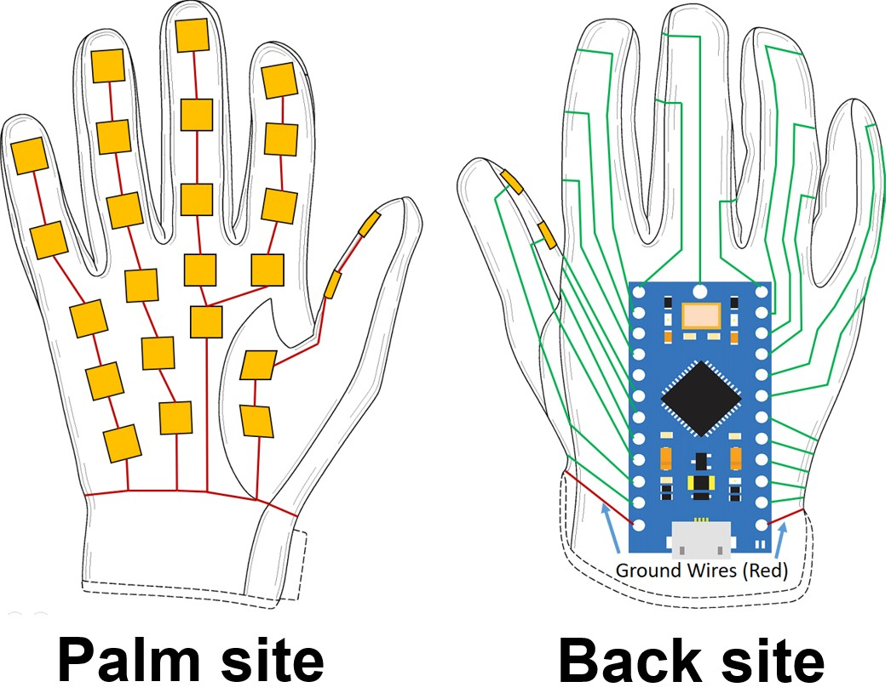
Solution Schematic:
Quantitative Spasticity Evaluation Device:
Features:
-PDMS Capacitive Sensors
-BLE & USB Communication
-Long Battery Life
-Portable/Lightweight
-GUI to Collect/Display Data
-Durable Glove Construction
-Quantify Spasticity
-Accurate 16 bit Resolution
Capacitive Pressure Sensors

Slide 8
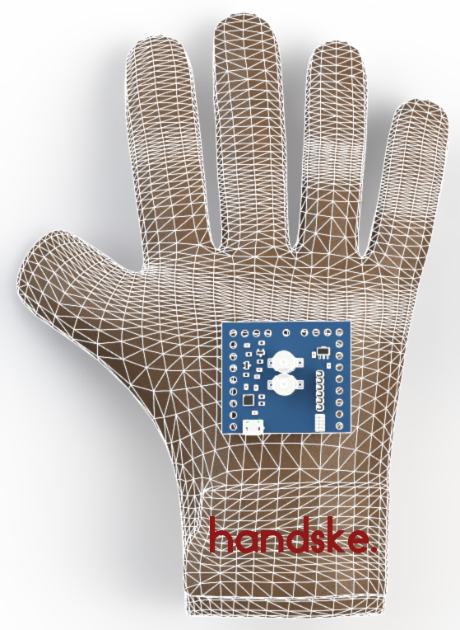
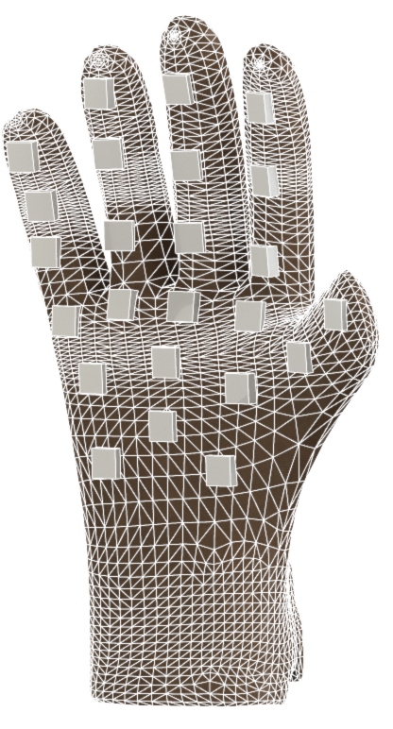
Glove Construction:CAD
Capacitive Pressure Sensors
DAQ/BLE XR48
FRONT GLOVE
BACK GLOVE

Slide 9
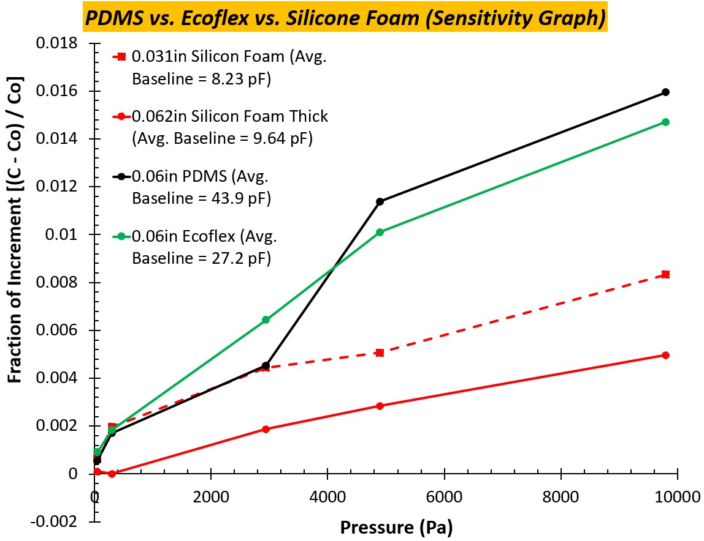
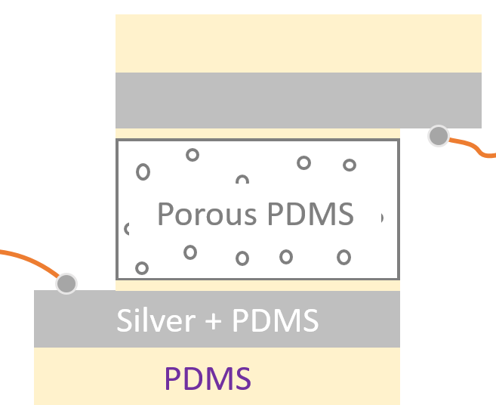
Glove Construction: Sensors
cloth ₊
Glove
Add a thin layer of PDMS on fabric and put a sensor on it. Let the complex cure
SENSOR SENSITIVITY
SENSOR CONSTRUCTION

Slide 10
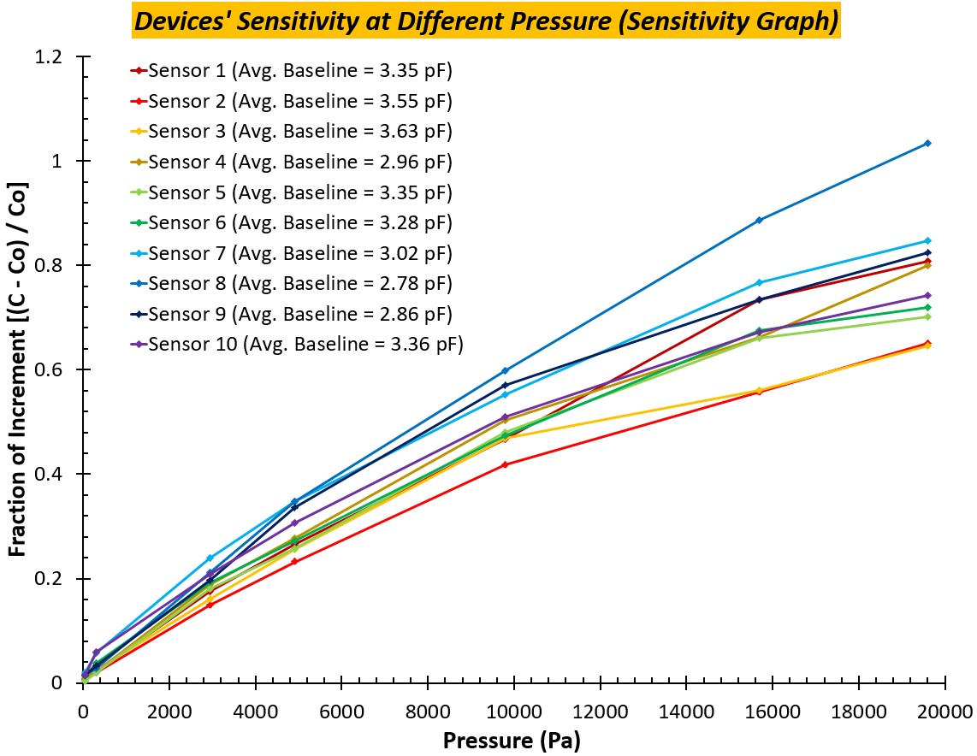
Prototype: Sensor Sensitivity
Capacitive Sensors:
-Highly Sensitivity
-Large Range
-Higher Resolution
-Numerical Value of Force
-Low ESR = Longer Battery

Slide 11
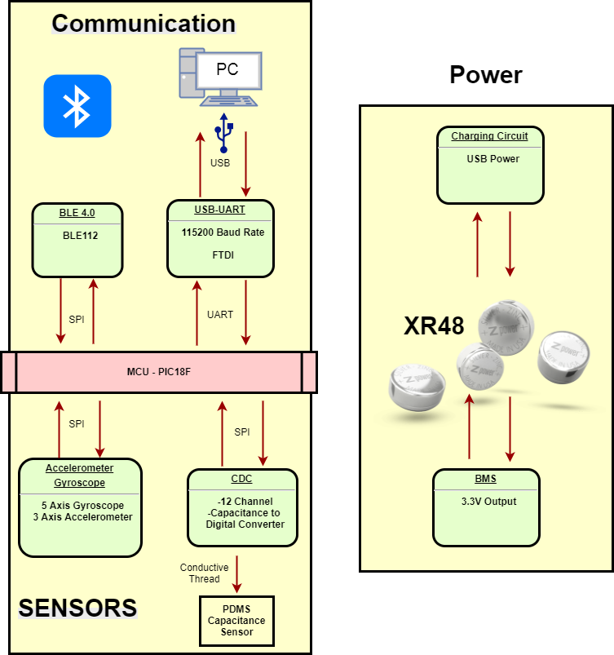
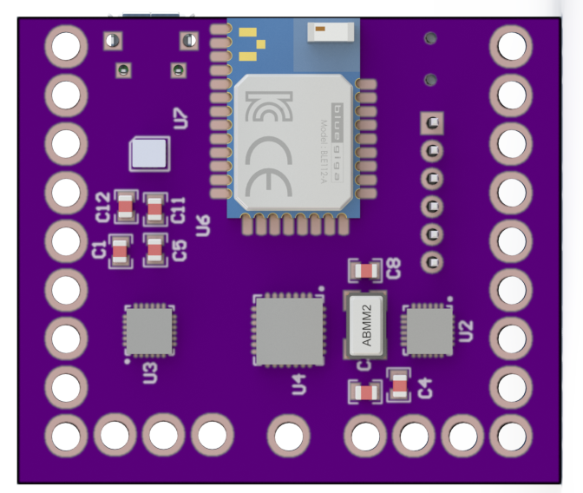
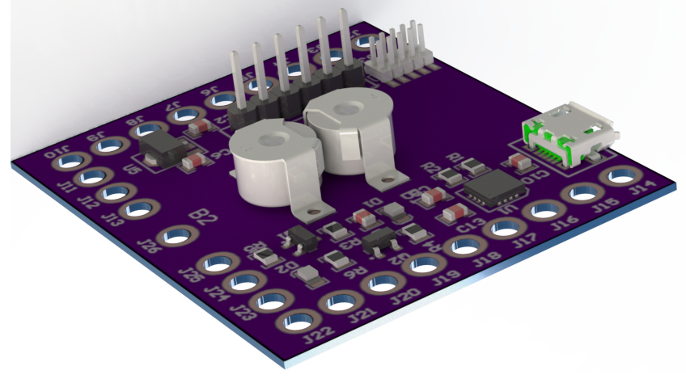
Glove Construction:PCB
BLE
CDC
XR48

Slide 12
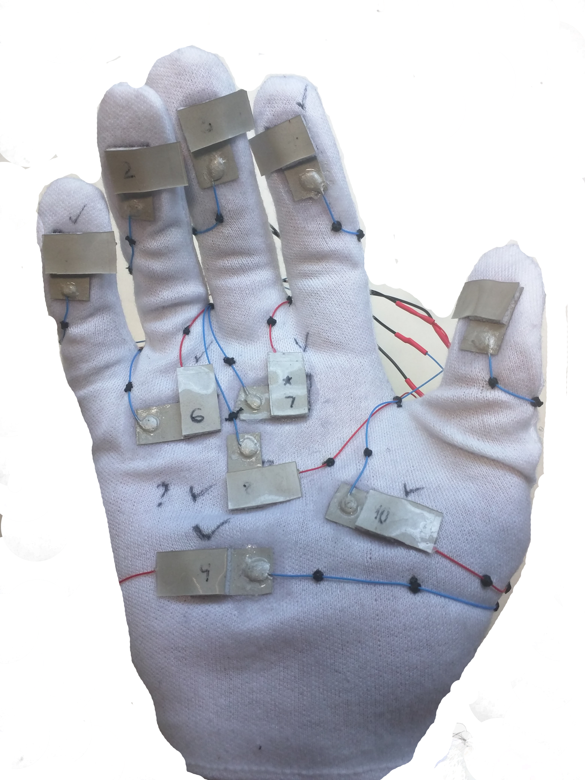
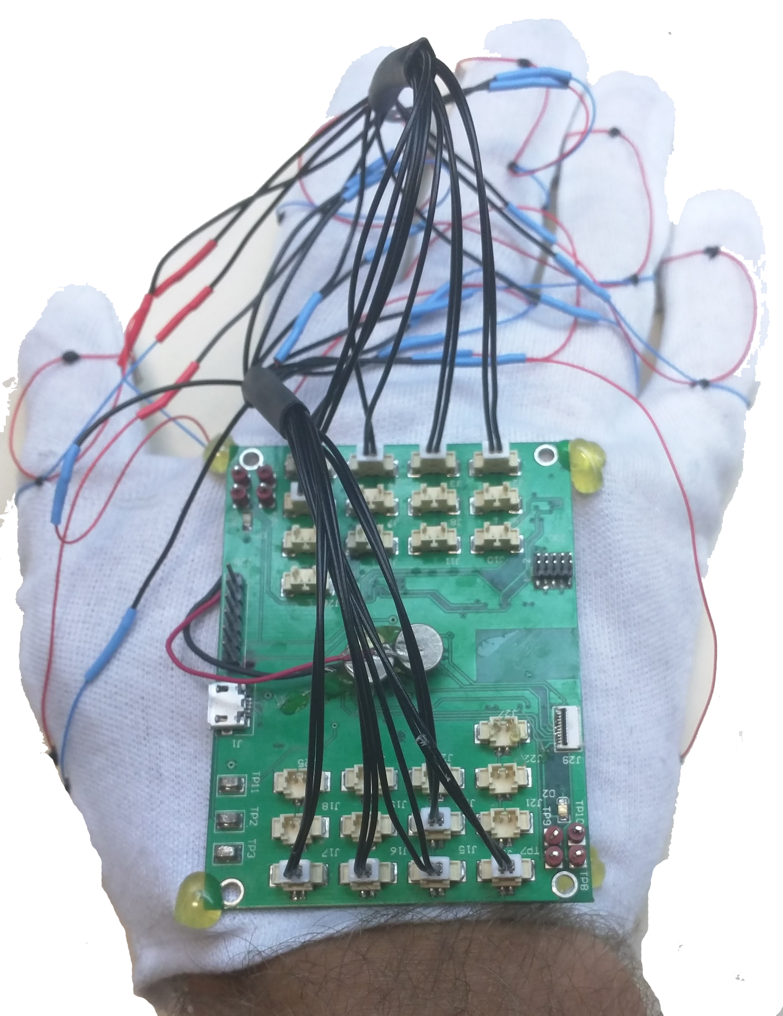
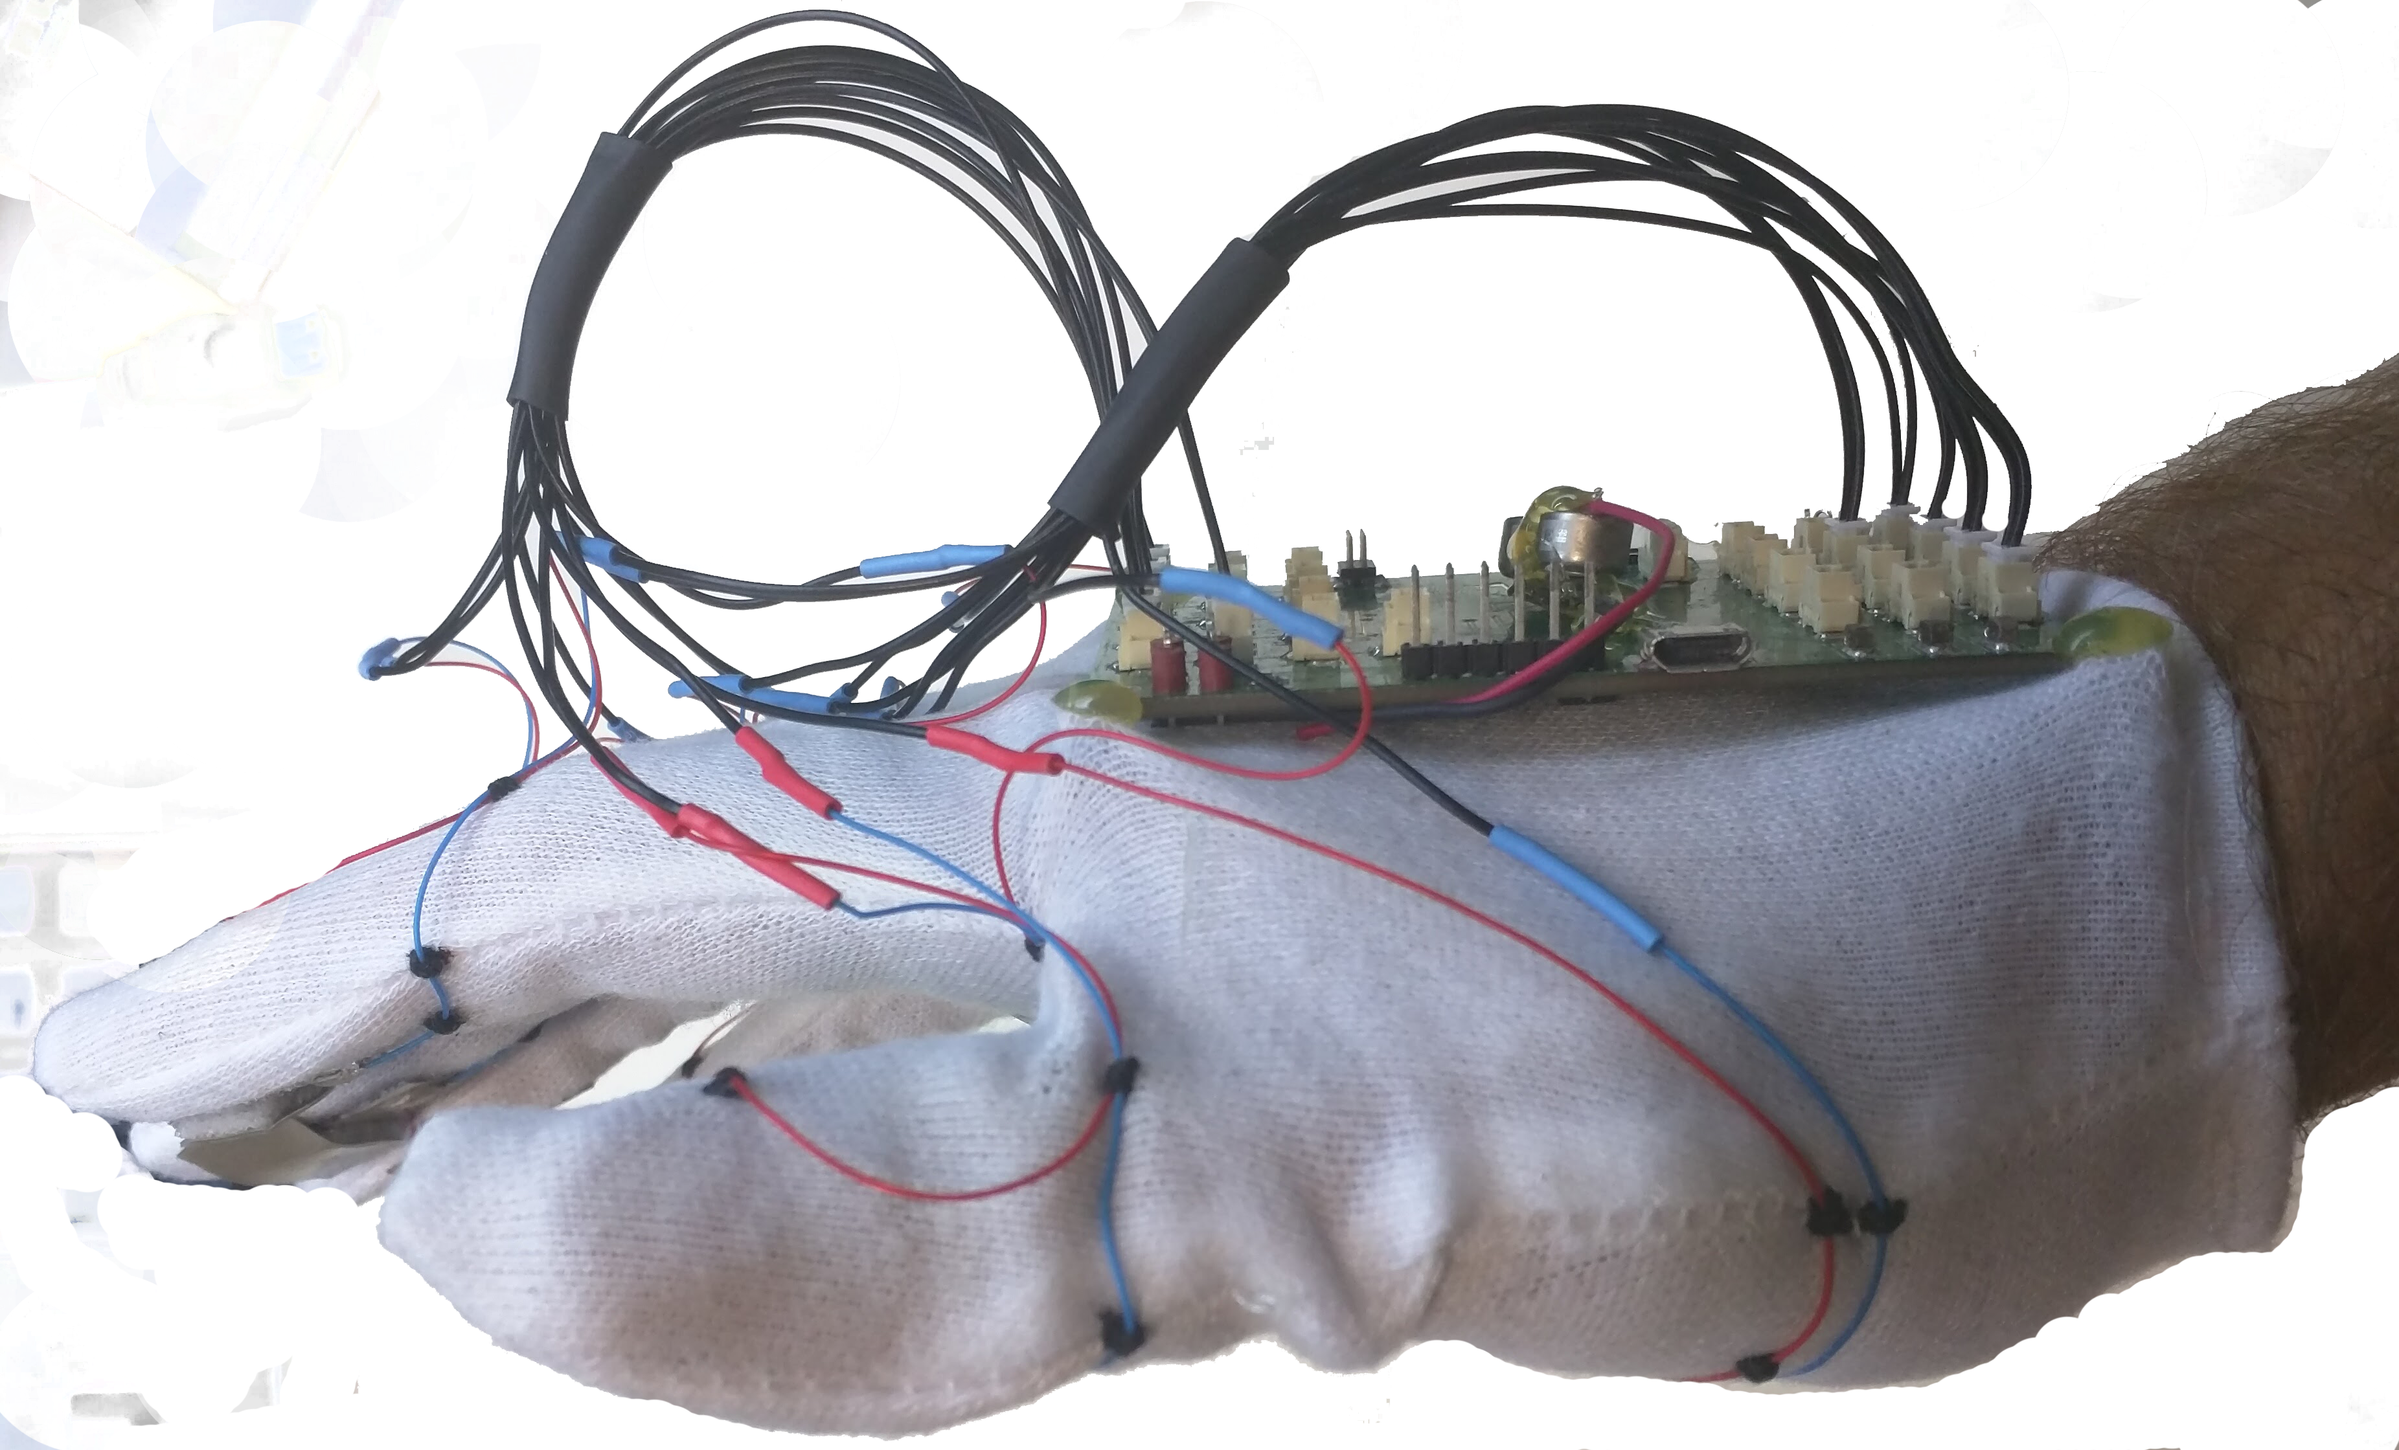
Existing Prototype:
SIDE
BACK
FRONT
VIDEO LINK: https://youtu.be/DI_lPKCn5Hs

Slide 13
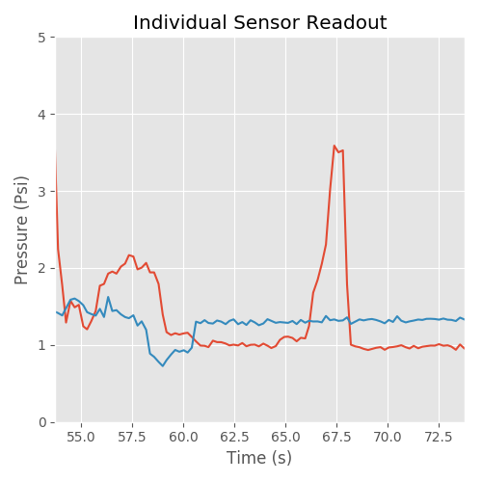
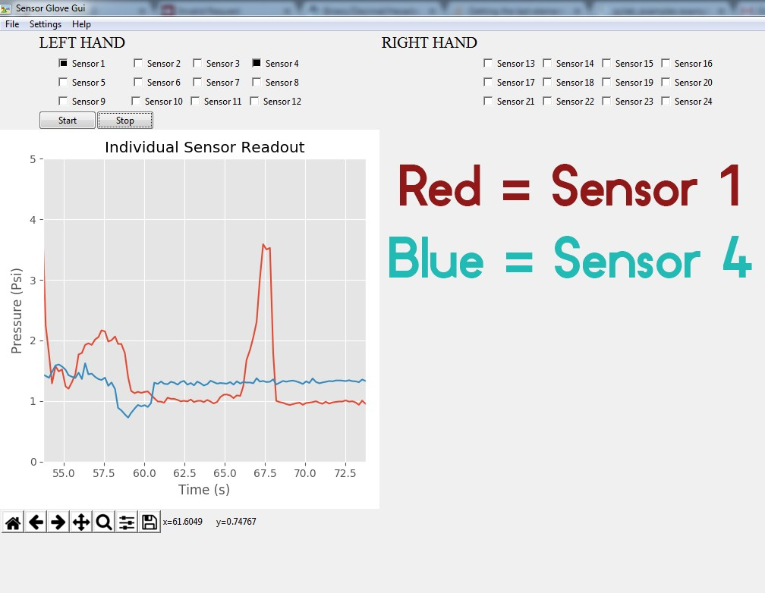
Existing GUI:
PYTHON GUI:
-Live Plotting
-Sensor Calibration
-Graph Image Saved
-EXCEL Data Saved

Slide 14
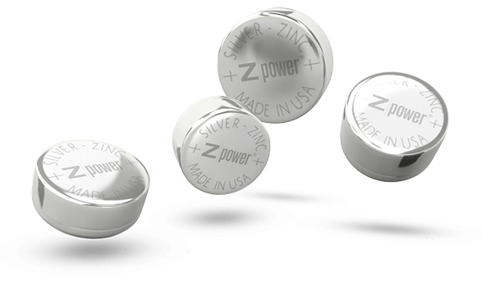

Prototype: Power Management
Power Requirements:
-CDC 1 mA (x2)
-MCU 10 mA(x1)
-BLE 27 mA(x1)
-Duty Cycle: 0.5 Seconds
Battery Needs:
-High Energy Density
-Small Package Size
-Numerous Recharges
XR48
Estimated Battery Life: 1.3 Hour Active Data Recording

